Slide 1
Aβ or not Aβ?… That is the Question!
Skylar Suarez & Larry Baker
BIOE 5100 Spring 2025

Slide 2
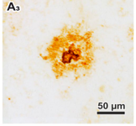
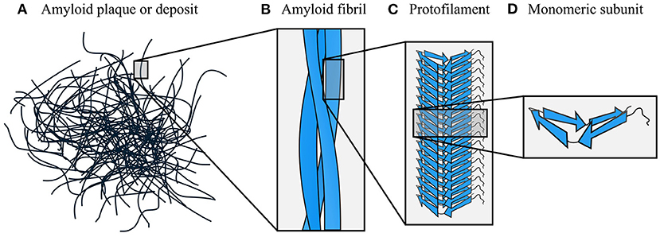
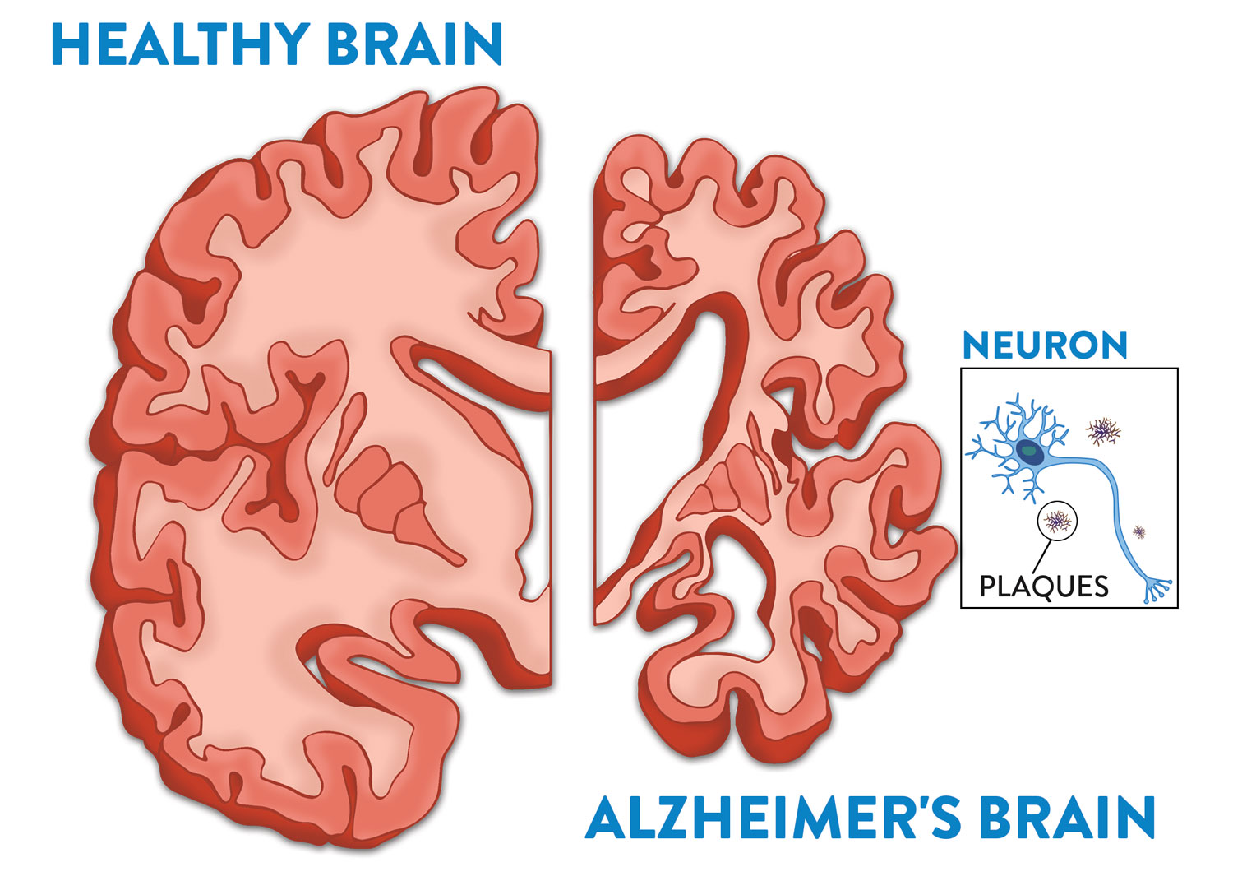
Amyloid-β (Aβ)
Monomeric Subunit Protofilament Amyloid Fibril Plaque
Rohr [2]
Taylor [1]
Big picture goal: to come up with a way to image these plaques without any stains or dyes.
So far, we have seen moderate success by exciting using light of near-UV wavelengths (300-450 nm).
Notes:
In AD, there is a protein called amyloid beta that misfolds, becomes sticky, aggregates together, and forms “plaques”.
The plaques deposit themselves in neural tissue and interfere with normal function, eventually leading to the dementia and memory loss characteristic of AD.

Slide 3
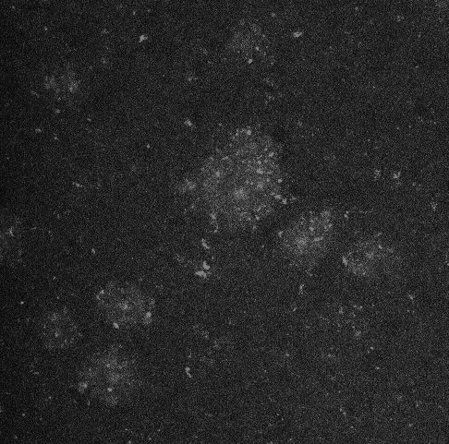
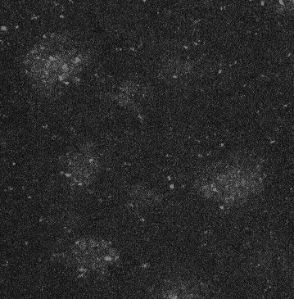
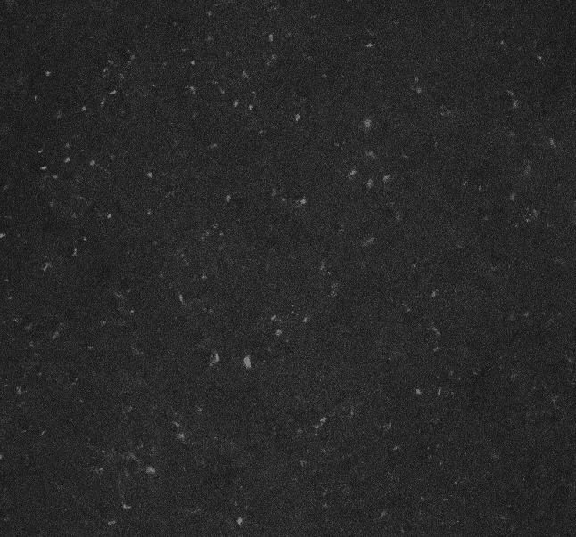
The Problem:
can we tell whether an image has Aβ plaques or not using computer vision?
5xFAD (AD mouse model) Hippocampus
C57 (control, no AD) Hippocampus
Confocal Microscope
λ_{ex} = 405 nm
λ_{em} = 425 – 475 nm
GOAL OF THIS PROJECT: classify the images between AD (has plaques) and NOT AD (no plaques)
Notes:
These images were taken on a confocal microscope using a DAP excitation and emission filter (ex 405 em 425-475). They are part of a proof-of-concept project I worked on last year.
These are slices of hippocampus brain tissue from 5xFAD transgenic mice – they get plaques starting at 5 months old.
The “blobs” you see are allegedly AB plaques. They may be hard to see at times, but they are there. I have a collection of ~40 of these images, all from various slices from 3 different mice.
THE GOAL: to classify the images between AD and not AD.

Slide 4
Roadblocks
Not all images are the same size.
Our dataset is only 52 total images
Both AD and control images have speckling.
This comes from proteins we cannot avoid because they autofluoresce at our current λ_{ex} and λ_{em}

Slide 5
Image Collection
Uniform Downsizing
Low-Pass Frequency Filtering
Gray-Level Co-Occurrence Matrix (texture)
K-Means Clustering
Standardizing
Logistic Regression
Decision Tree
Logistic Regression
Decision Tree

Slide 6
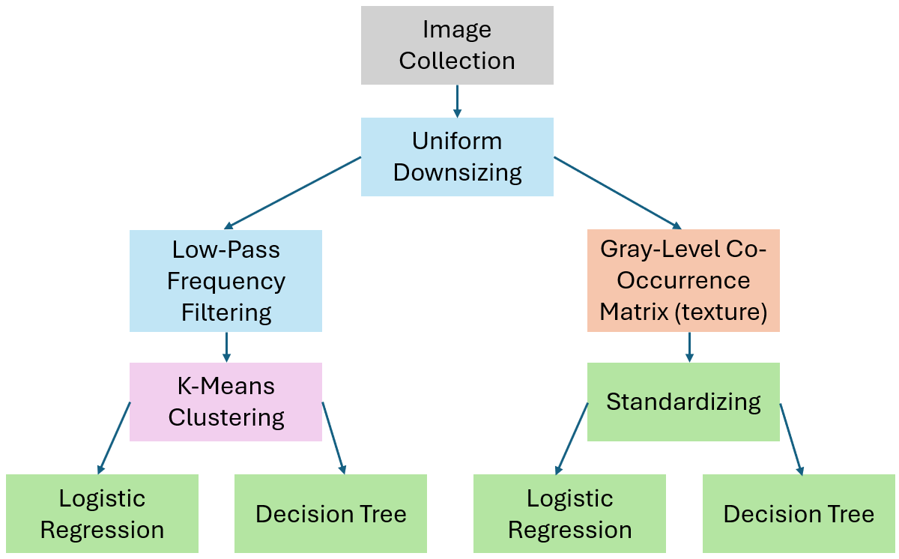
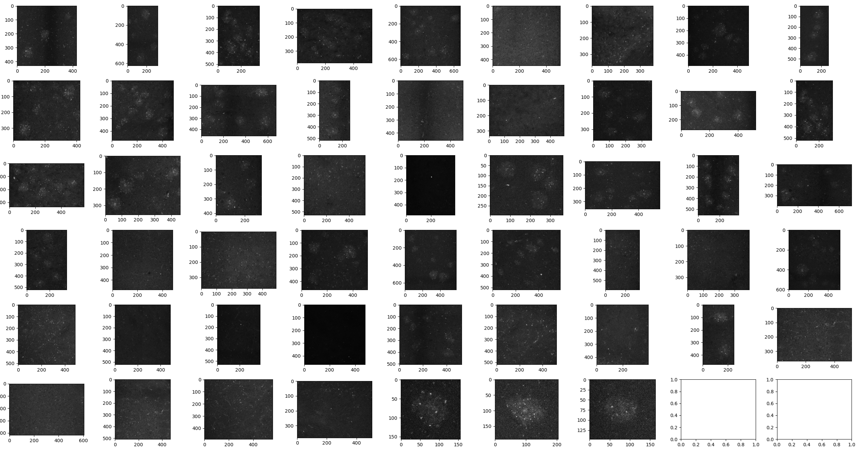
Addressing roadblock 1: Images of different sizes
↑ sizing
↑ computing time
No data is deleted, but…
Can introduce artificial data when that may not be true to the original content
↓sizing
↓ computing time
Deleting pixels and intensities = losing important details/texture
No artificial data introduced
resize(min # of rows, min # cols)
Notes:
We upsized all images to the max #rows and #cols
Downsizing would have meant less computing time, but it would also mean deleting pixels/intensities, losing some info, and higher risk of overfitting

Slide 7
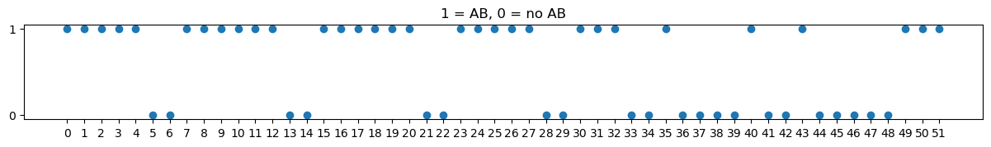
Notes:
This is our entire dataset (before resizing) and their actual classifications.

Slide 8
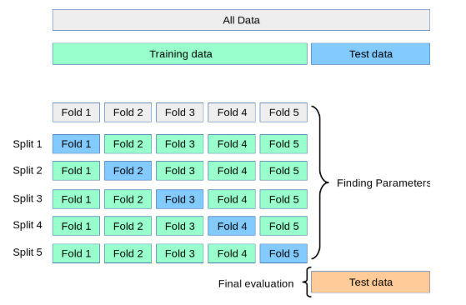
Addressing roadblock 2: Small dataset of 52 images
Cross-Validation: split the training data into k-folds (subsets), use one fold as a temporary “test” set and train with the rest. Repeat until all folds have been used for testing.
Why?
This helps us do more training with our small dataset. It also lets us estimate how well the model will do with previously unseen data (our actual test set).
Image source: https://www.justintodata.com/cross-validation-machine-learning/

Slide 9
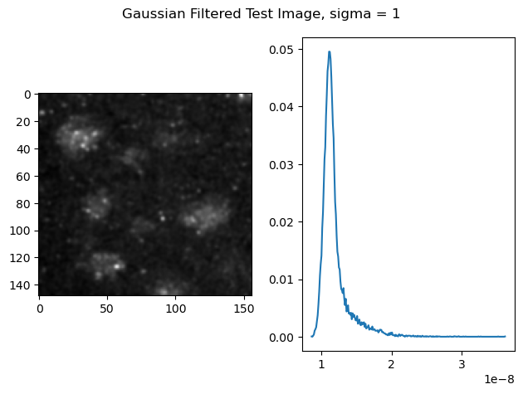
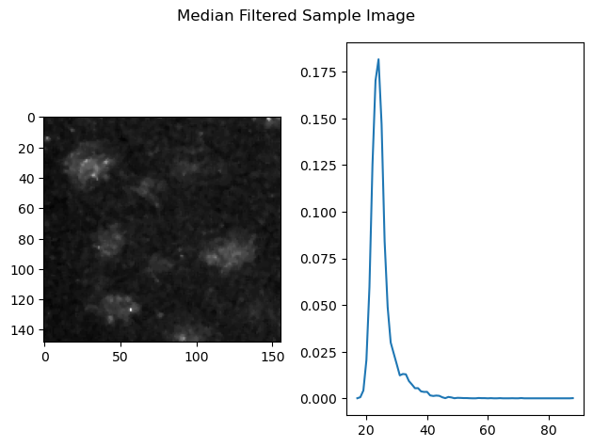
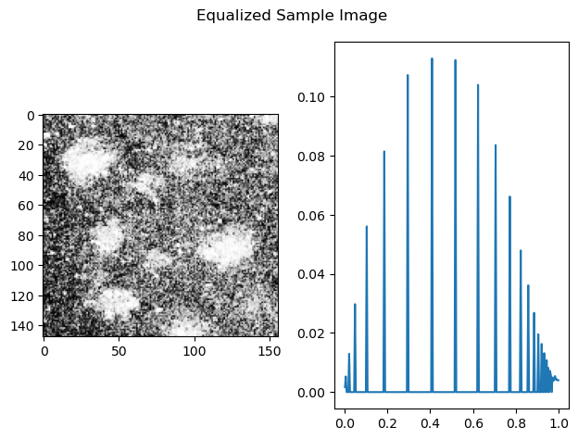
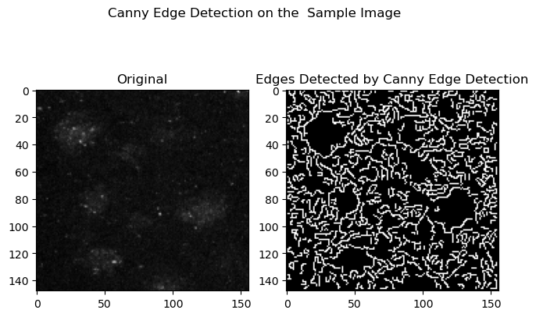
What We Tried But DIDN’T End Up Using
Notes:
What we tried but DIDN’T end up using

Slide 10
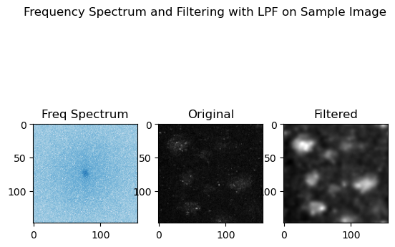
What We DID End Up Using
Notes:
(circle/mark the spectra we did keep on the frequency spectrum graph)

Slide 11
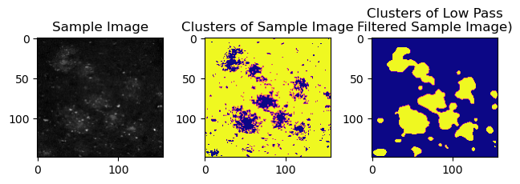
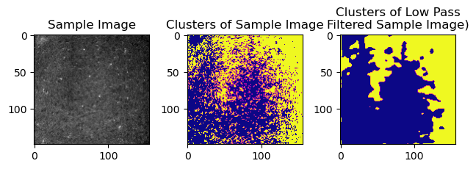
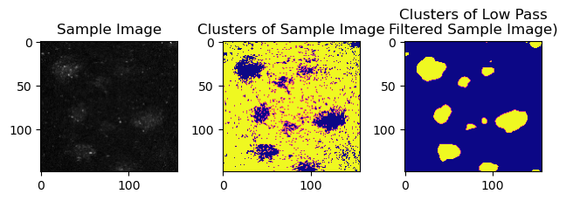
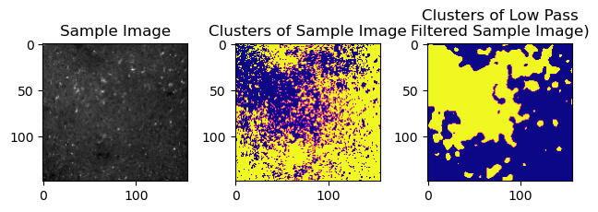
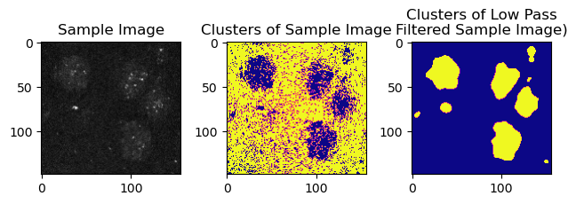
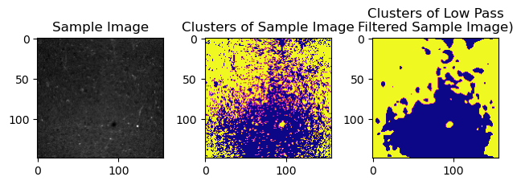
K-Means Clustering
Notes:
Talk about k means clustering

Slide 12
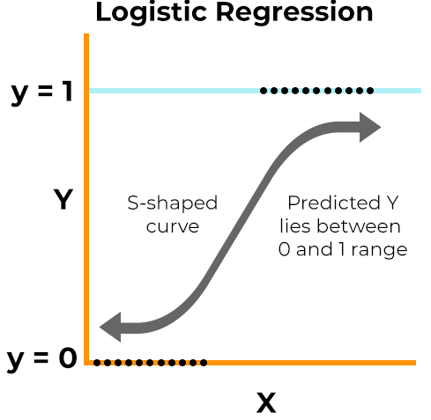
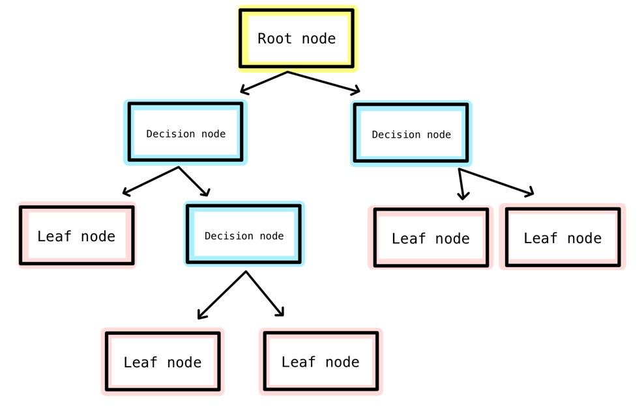
Decision Trees
Makes an S-shaped curve that tells us the probability of each image belonging to each class (0 or 1)
Starts with the root node having ALL the data, then recursively splits it into decision nodes based on features, branching out until it reaches the final classifications.
Image source: https://www.spiceworks.com/tech/artificial-intelligence/articles/what-is-logistic-regression/
Image source: https://medium.com/@chyun55555/decision-tree-classifier-with-scikit-learn-from-python-e83f38079fea
Notes:
DT: Starts with the root node having ALL the data to start. It splits the data into decision nodes based on features, branching out until it reaches the nodes that represent the final classifications.

Slide 13
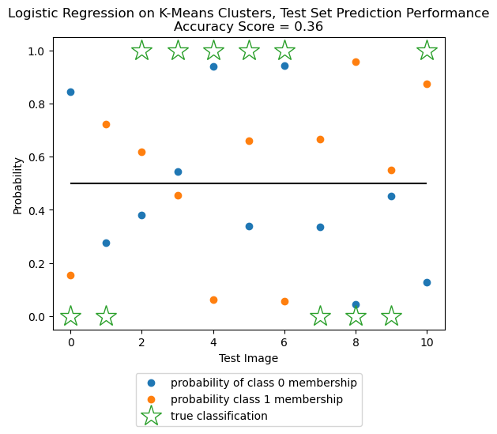
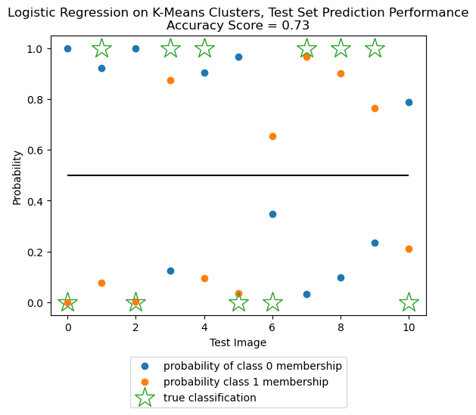
Classification via Logistic Regression
on K-Means Cluster Data
Average Logistic Regression Mean Squared Errors, CV with 5 folds = 0.57
Average Logistic Regression Mean Squared Errors, CV with 10 folds = 0.35
Notes:
Left is cv=5
Right is cv=10

Slide 14
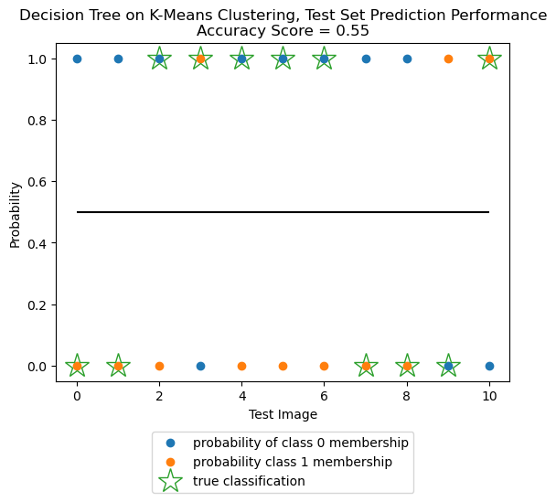
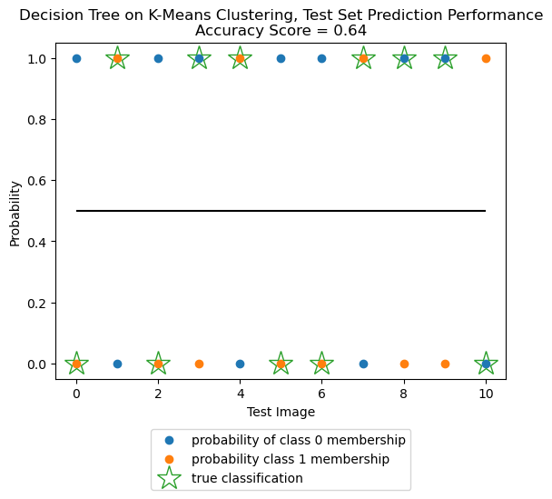
Classification via Decision Trees
on K-Means Cluster Data
Average Decision Tree Mean Squared Errors, CV with 5 folds = 0.49
Average Decision Tree Mean Squared Errors, CV with 10 folds = 0.34
Notes:
These are the results of LR on the test set

Slide 15
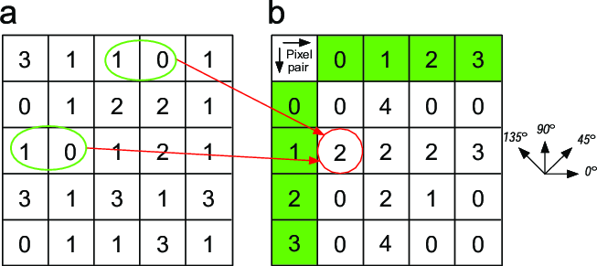
Gray Level Co-Occurrence Matrix (GLCM)
Features:
ASM
Contrast
Correlation
Dissimilarity
Homogeneity
Notes:
(add quick/short definitions of each feature)

Slide 16
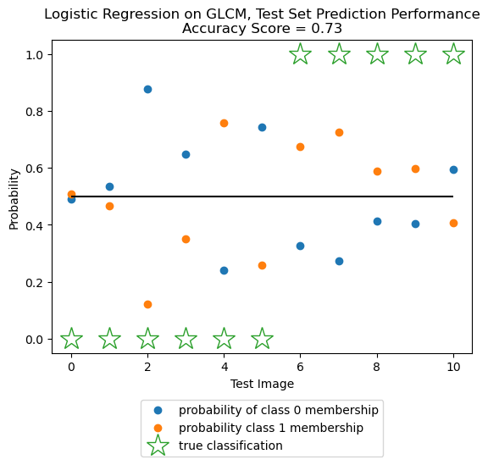
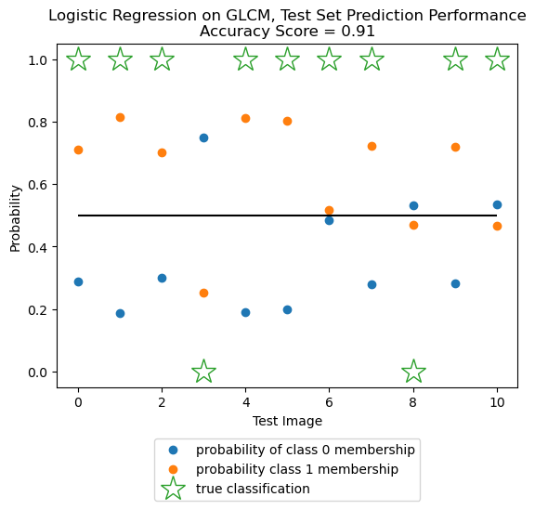
Classification via Logistic Regression
on GLCM (texture) Data
Average Logistic Regression Mean Squared Errors, CV with 5 folds = 0.54
Average Logistic Regression Mean Squared Errors, CV of 10 folds= 0.47
Notes:
These are the results of LR on the test set

Slide 17
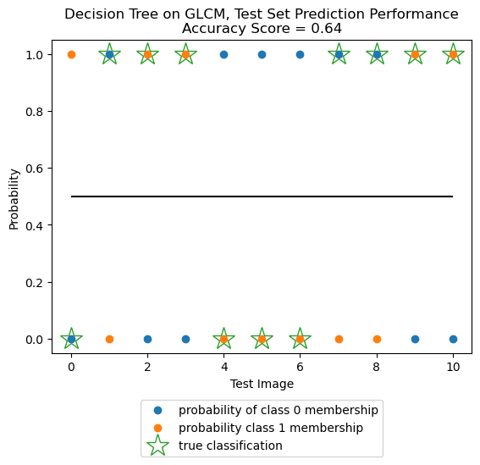
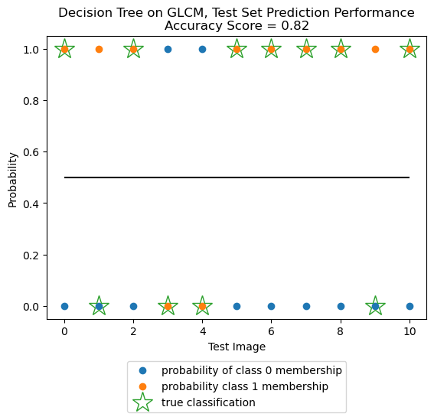
Classification via Decision Trees
on GLCM (texture) Data
Average Decision Tree Mean Squared Errors, CV with 5 folds = 0.6
Average Decision Tree Mean Squared Errors, CV with 10 folds = 0.45
Notes:
These are the results of LR on the test set

